Slide 1




University Institute of Engineering
Department of Computer Science & Engineering
COMPUTER ORGANIZATION & ARCHITECTURE
(23CST-204/23ITT-204)
ER. SHIKHA ATWAL
E11186
ASSISTANT PROFESSOR
BE-CSE

Slide 2
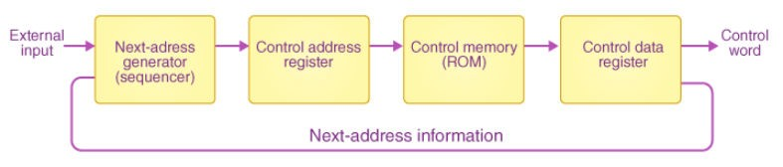
MICRO-PROGRAMMED CONTROL UNIT
The programming approach is used to implement a microprogrammed control unit. A program made up of microinstructions is used to carry out a series of micro-operations. The control unit’s control memory stores a microprogram composed of microinstructions. The creation of a set of control signals is dependent on the execution of a microinstruction.
The block diagram of this type of organization is shown below:
Micro-Programmed Control Unit

Slide 3
Characteristics of Micro-programmed Control Unit
The microinstruction address is specified in the control memory address register.
All the control information is saved in the control memory, which is considered to be a ROM.
The microinstruction received from memory is stored in the control register.
A control word in the microinstruction specifies one or multiple micro-operations for a data processor.
The next address is calculated in the circuit of the next address generator and then transferred to the control address register for reading the next microinstruction when the micro-operations are being executed.
Because it determines the sequence of addresses received from control memory, the next address generator is also known as a microprogram sequencer.

Slide 4
Designing of Micro-programmed Control Unit
The existence of the control store, which is used to store words containing encoded control signals required for instruction execution, is the main distinction between microprogrammed structures and the hardwired control unit structure.
Each bit in the microinstruction is connected to a single control signal. The control signal is active when the bit is set., and it becomes inactive when it is cleared. A sequence of these microinstructions can be kept in the internal ‘control’ memory. A microprogram-controlled computer’s control unit is a computer within a computer.

Slide 5
Some Important Terms –
Control Word: A control word is a word whose individual bits represent various control signals.
Micro-routine: A sequence of control words corresponding to the control sequence of a machine instruction constitutes the micro-routine for that instruction.
Micro-instruction: Individual control words in this micro-routine are referred to as microinstructions.
Micro-program: A sequence of micro-instructions is called a micro-program, which is stored in a ROM or RAM called a Control Memory (CM).
Control Store: the micro-routines for all instructions in the instruction set of a computer are stored in a special memory called the Control Store.

Slide 6
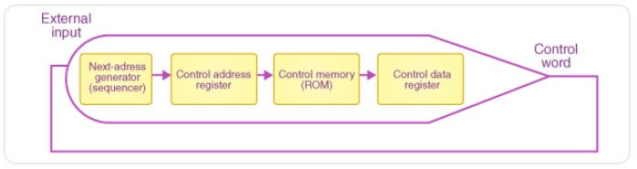
Here is the block diagram:
Micro-Programmed Control Unit Organization
Working of Micro-programmed Control Unit
The instruction words are normally fetched into the instruction register in micro-programmed control units.
The operation code of each instruction, on the other hand, is not directly decoded to enable instant control signal generation; instead, it contains the initial address of a microprogram in the control store.

Slide 7
The control store address register receives the instruction opcode from the instruction register.
The first microinstruction of a microprogram that interprets the execution of such an instruction is read to the microinstruction register based on this address.
The operation element of this microinstruction contains encoded control signals, usually in the form of a few bit fields. The fields are decoded using a collection of microinstruction field decoders.
The address of the next microinstruction in the supplied instruction microprogram is also included in the microinstruction, as well as a control field for controlling the microinstruction address generator’s actions.

Slide 8
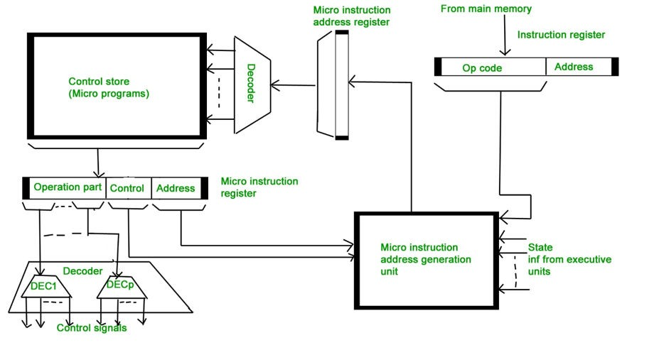
Microprogrammed Control Unit

Slide 9
The addressing mode or addressing operation that is to be applied to the address encoded in the continuing microinstruction is determined by the last-mentioned field.
This address is refined in microinstructions and conditional addressing mode by employing the processor condition flags, which describe the status of calculations in the current program.
The microinstruction that fetches the very next instruction to the instruction register from the main memory is the last microinstruction in the instruction of the provided microprogram.

Slide 10
Types of Micro-programmed Control Unit
Based on the type of Control Word stored in the Control Memory (CM), it is classified into two types:
Horizontal Micro-programmed control Unit:
The control signals are represented in the decoded binary format that is 1 bit/CS.
Example: If 53 Control signals are present in the processor than 53 bits are required. More than 1 control signal can be enabled at a time.
It supports longer control word.
It is used in parallel processing applications.
It allows higher degree of parallelism. If degree is n, n CS are enabled at a time.
It requires no additional hardware(decoders). It means it is faster than Vertical Microprogrammed.
It is more flexible than vertical microprogrammed

Slide 11
2. Vertical Micro-programmed control Unit:
The control signals re represented in the encoded binary format. For N control signals- Log2(N) bits are required.
It supports shorter control words.
It supports easy implementation of new control signals therefore it is more flexible.
It allows low degree of parallelism i.e. degree of parallelism is either 0 or 1.
Requires an additional hardware (decoders) to generate control signals, it implies it is slower than horizontal microprogrammed.
It is less flexible than horizontal but more flexible than that of hardwired control unit.

Slide 12
Advantages of Micro-Programmed Control Unit
It allows for a more methodical control unit design.
It’s easier to troubleshoot and modify.
It can keep the control function’s fundamental structure.
It can make the control unit’s design easier. As a result, it is less expensive and less prone to errors or glitches.
It has the ability to design in a methodical and ordered manner.
It is used to control software-based functions rather than hardware-based functions.
It’s more adaptable.
It is used to do complex functions with ease.

Slide 13
Disadvantages of Micro-Programmed Control Unit
Adaptability comes at a higher price.
It is comparatively slower than a control unit that is hardwired.

Slide 14
References
Reference Books:
J.P. Hayes, “Computer Architecture and Organization”, Third Edition.
Mano, M., “Computer System Architecture”, Third Edition, Prentice Hall.
Stallings, W., “Computer Organization and Architecture”, Eighth Edition, Pearson Education.
Text Books:
Carpinelli J.D,” Computer systems organization &Architecture”, Fourth Edition, Addison Wesley.
Patterson and Hennessy, “Computer Architecture” , Fifth Edition Morgaon Kauffman.

Slide 15
Other References:
http://www.pvpsiddhartha.ac.in/dep_it/lecturenotes/CSA/unit-3.pdf
http://www.cs.binghamton.edu/~reckert/hardwire3new.html
https://www.geeksforgeeks.org/last-minute-notes-computer-organization/
https://bmsit.ac.in/system/study_materials/documents/000/000/007/original/Comp uter_Organization_Chapter7.pdf?1477057102
https://www.javatpoint.com/design-of-control-unit
Reference Video Links:
https://youtu.be/fqe8n_7ln2c?si=hgui5tMiCt-ZPU7g
https://www.youtube.com/live/tYiC5xqDzBc?si=shs5d4bTt99AO4wL
https://youtu.be/5Sk5OpoT66E?si=DoCgVZ36iUTQDyB2

